Slide 1
Large-scale Video Classification with Convolutional Neural Networks
By Andrej Karpathy, George Toderici, Sanketh Shetty, Thomas Leung, Rahul Sukthankar, Li Fei-Fei
Published on September 25^{th,} 2014
Name: SNEHAN REDDY MARRI
700#: 700745309
CRN: 30828

Slide 2
Motivation
Convolutional neural networks, or CNNs, have proven to be a successful class of models for comprehending image material, providing cutting-edge outcomes for image identification, segmentation, retrieval, and recognition.
The key enabling factors behind these results were techniques for scaling up the networks to tens of millions of parameters and massive labeled datasets that can support the learning process.
Encouraged by positive results in domain of images, we study the performance of CNNs in large-scale video classification, where the networks have access to not only the appearance information present in single, static images, but also their complex temporal evolution.

Slide 3
Problem Statement
There are several challenges to extending and applying CNNs in this setting. From a practical standpoint, there are currently no video classification benchmarks that match the scale and variety of existing image datasets because videos are significantly more difficult to collect, annotate and store.
From a modeling perspective, we are interested in answering the following questions: what temporal connectivity pattern in a CNN architecture is best at taking advantage of local motion information present in the video? How does the additional motion information influence the predictions of a CNN and how much does it improve performance overall?

Slide 4
Objectives
We provide extensive experimental evaluation of multiple approaches for extending CNNs into video classification on a large-scale dataset of 1 million videos with 487 categories (which we release as Sports-1M dataset) and report significant gains in performance over strong feature-based baselines.
We highlight an architecture that processes input at two spatial resolutions - a low-resolution context stream and a high-resolution fovea stream - as a promising way of improving the runtime performance of CNNs at no cost in accuracy.
We apply our networks to the UCF-101 dataset and report significant improvement over feature-based state of the art results and baselines established by training networks on UCF-101 alone.

Slide 5
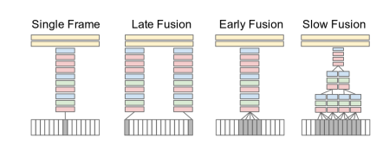
Contributions
There are multiple options for the precise details of the extended connectivity, and we describe three broad connectivity pattern categories (Early Fusion, Late Fusion and Slow Fusion) below

Slide 6
Contributions
Early Fusion: Early Fusion extension combines information across an entire time window immediately on the pixel level. This is implemented by modifying the filters on the first convolutional layer in the single-frame model by extending them to be of size 11 × 11 × 3 × T pixels
Late Fusion: Late Fusion model places two separate single-frame networks, as described above, up to last convolutional with shared parameters a distance of 15 frames apart and then merges the two streams in the first fully connected layer. Therefore, neither single frame tower alone can detect any motion, but the first fully connected layer can compute global motion characteristics by comparing outputs of both towers.

Slide 7
Contributions
Slow Fusion: The Slow Fusion model is a balanced mix between the two approaches that slowly fuses temporal information throughout the network. This is implemented by extending the connectivity of all convolutional layers in time and carrying out temporal convolutions in addition to spatial convolutions to compute activations.
One approach to speeding up the networks is to reduce the number of layers and neurons in each layer, but we found that this consistently lowers the performance. Instead of reducing the size of the network, we conducted further experiments on training with images of lower resolution.

Slide 8
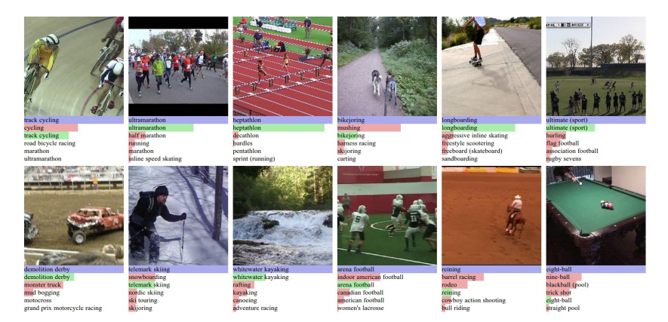
Results
Predictions on Sports-1M test data. Blue (first row) indicates ground truth label and the bars below show model predictions sorted in decreasing confidence. Green and red distinguish correct and incorrect predictions, respectively

Slide 9
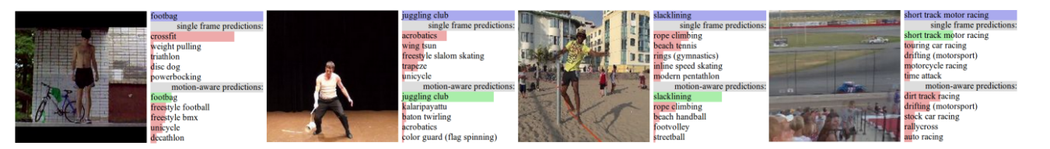
Results
Above example illustrate qualitative differences between single-frame network and Slow Fusion (motion-aware) network in the same color scheme as Figure 4. A few classes are easier to disambiguate with motion information (left three).

Slide 10
References
Y. LeCun, L. Bottou, Y. Bengio, and P. Haffner. Gradientbased learning applied to document recognition. Proceedings of the IEEE, 86(11):2278–2324, 1998
H. Wang, A. Klaser, C. Schmid, and C.-L. Liu. Action recognition by dense trajectories. In CVPR. IEEE, 2011.
I. Laptev, M. Marszalek, C. Schmid, and B. Rozenfeld. Learning realistic human actions from movies. In CVPR, 2008
G. W. Taylor, R. Fergus, Y. LeCun, and C. Bregler. Convolutional learning of spatio-temporal features. In ECCV. Springer, 2010.

Slide 11
Thank you!

